Slide 1



Covid Dashboard
View in Power BI
Last data refresh:
12/14/2021 6:47:40 PM UTC
Downloaded at:
12/15/2021 7:40:24 AM UTC

Slide 2
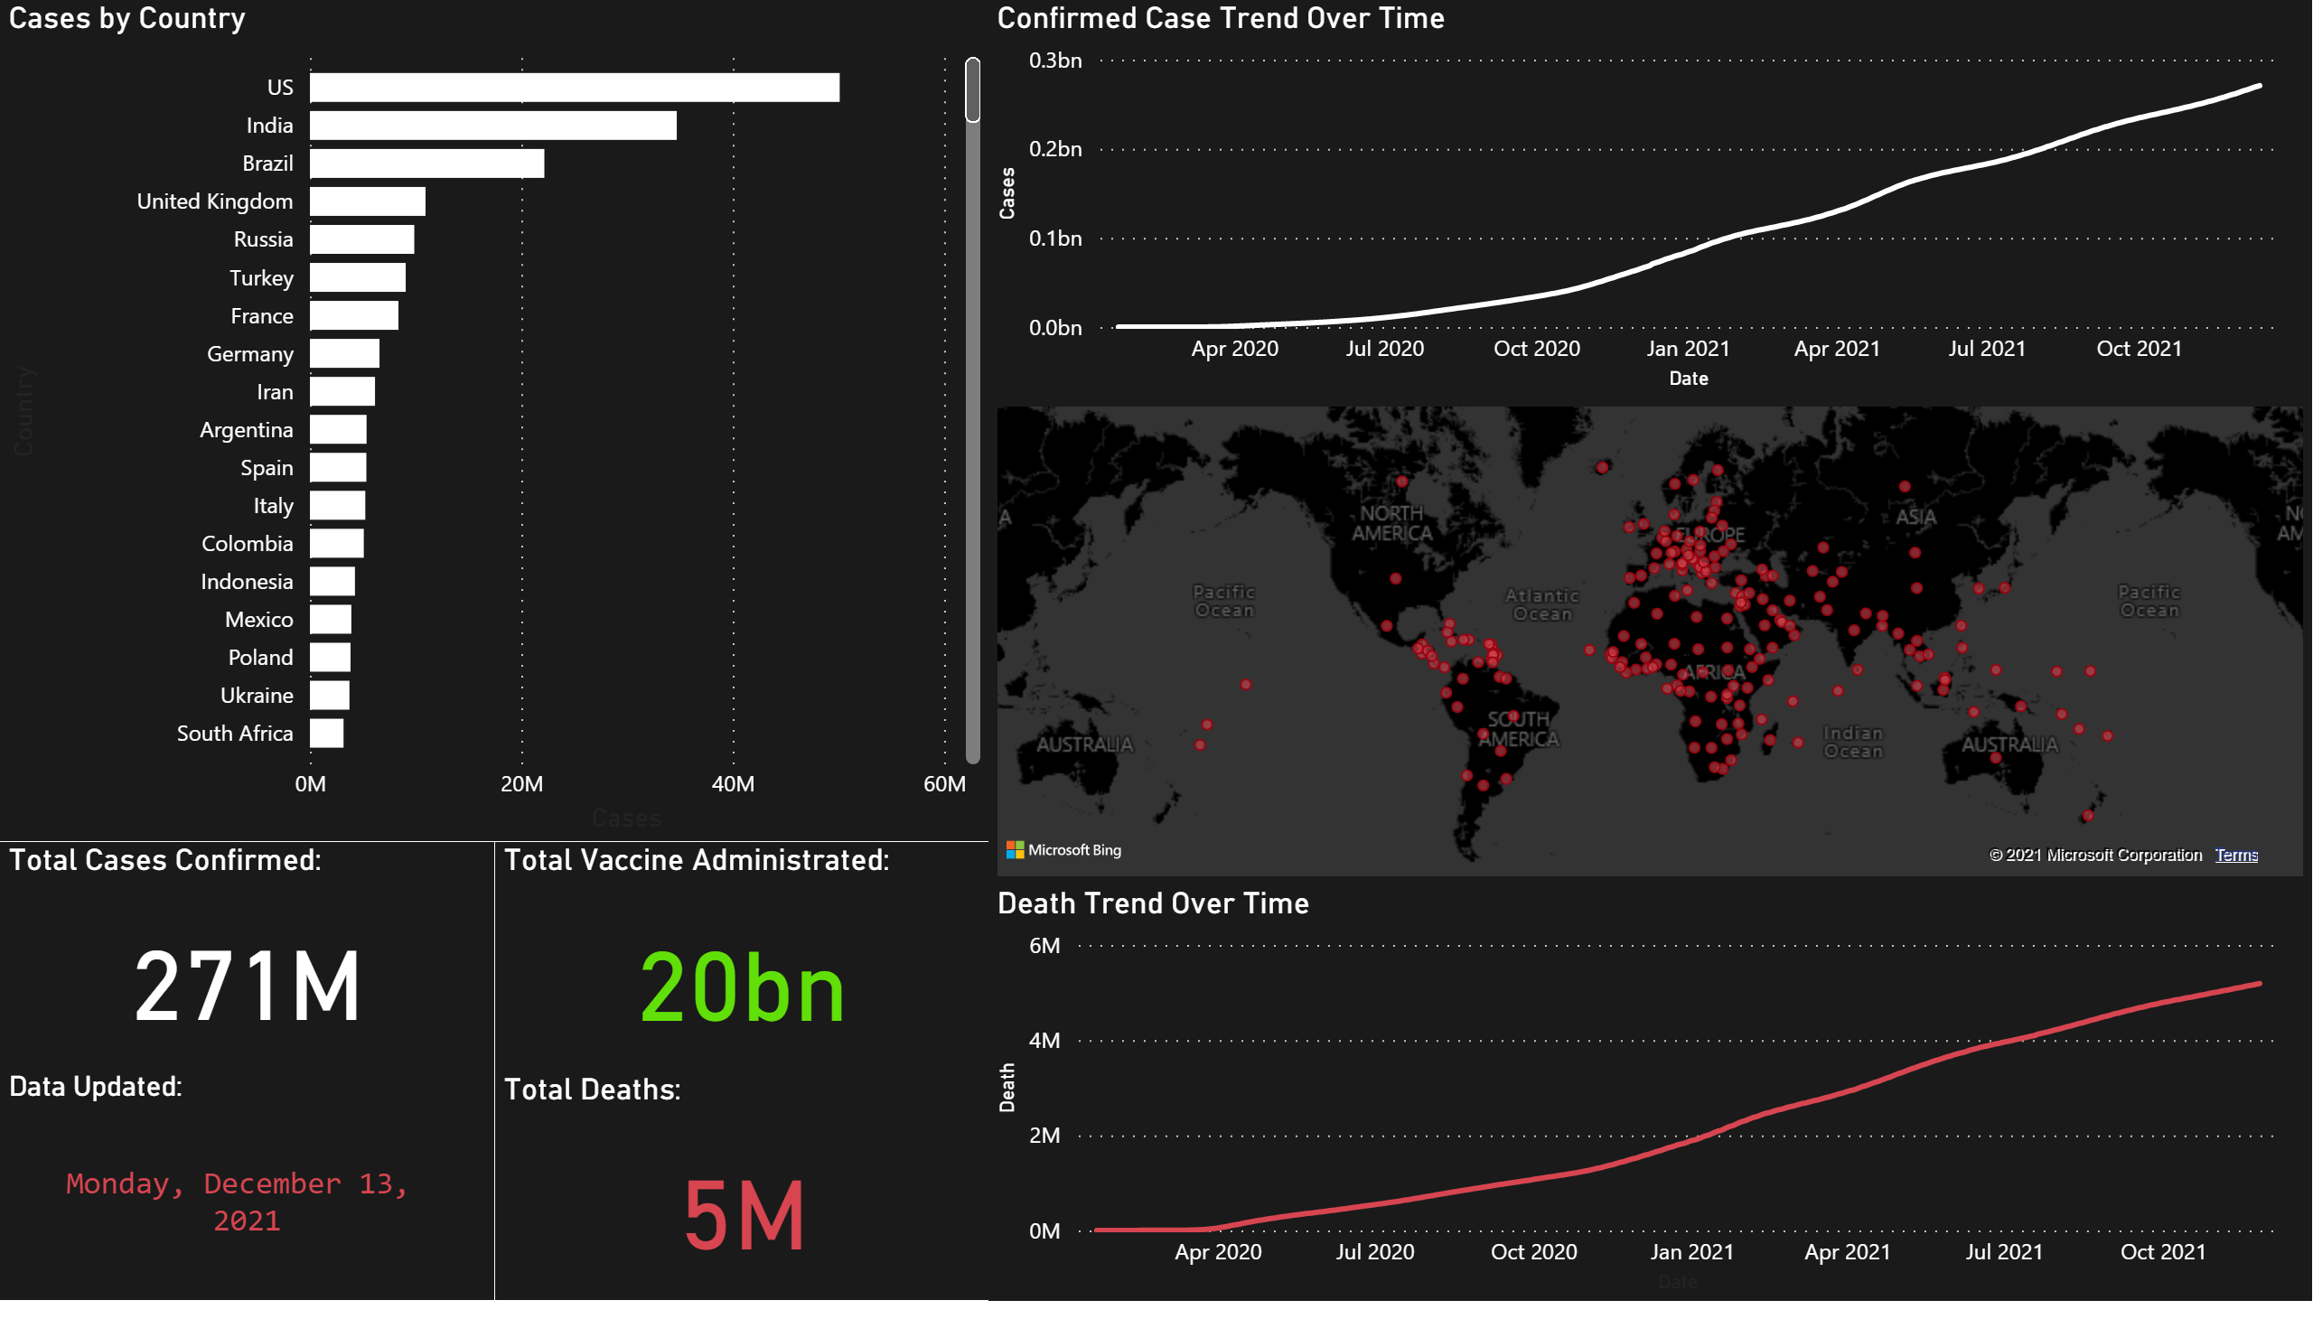
Global
Notes:
Cases by Country
No alt text provided.
Confirmed Case Trend Over Time
No alt text provided.
Data Updated:
No alt text provided.
Death Trend Over Time
No alt text provided.
Total Cases Confirmed:
No alt text provided.
Total Deaths:
No alt text provided.
Total Vaccine Administrated:
No alt text provided.
map
No alt text provided.

